Slide 1
Course Code:CSC402A Course Title: Web Architecture and Application Development
Course Leader:
Kishore S.M.
kishore.cs.et@msruas.ac.in

Slide 2
Objectives
After completing this lecture, the student will be able to
Describe data flow architecture
Describe about pipes and filters

Slide 3
Contents
Data Flow Architectures
Pipes and Filters

Slide 4
Data Flow Architectures
The data flow software architecture style views the entire software system as a series of transformations on successive sets of data, where data and operations on it are independent of each other.
The software system is decomposed into data processing elements where data directs and controls the order of data computation processing
Each component in this architecture transforms its input data into corresponding output data
The connection between the subsystem components may be implemented as I/O streams, I/O files, buffers, piped streams, or other types of connections
Data can flow in a graph topology with cycles or in a linear structure without cycles, or even in a tree type structure

Slide 5
Data Flow Architectures
There are many different ways to connect the output data of a module to the input of other modules which result in a range of data flow patterns. There are two categories of execution sequences between modules:
Batch Sequential
Pipe & Filter
The close-loop process control is a typical data flow architecture style where data also drives the sequence of the program executions.
From the standpoint of design orientation philosophy, we can choose either a traditional procedure-oriented design or an object-oriented design.

Slide 6
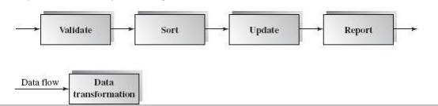
Data Flow Architectures
Batch Sequential
The batch sequential architecture style represents a traditional data processing model that was widely used from 1950 to 1970. RPG and COBOL are two typical programming languages working on this model.

Slide 7

Data Flow Architectures
We can run a Unix Shell script as follows in batch sequential mode:

Slide 8
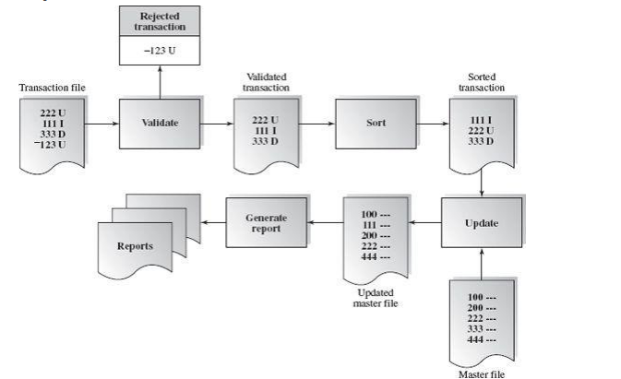
Data Flow Architectures

Slide 9
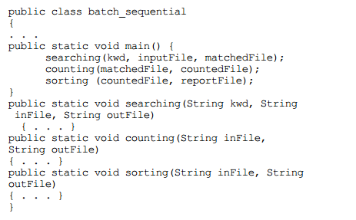
Data Flow Architectures
We can also implement the batch sequential software architecture at the programming language level.

Slide 10
Data Flow Architectures
Benefits:
Simple divisions on subsystems
Each subsystem can be a stand-alone program working on input data and producing output data
Limitations:
Implementation requires external control
It does not provide interactive interface
Concurrency is not supported and hence throughput remains low
High latency

Slide 11
Data Flow Architectures
Pipe and Filter Architecture
Pipe and filter architecture is another type of data flow architecture where the flow is driven by data.
This architecture decomposes the whole system into components of data source, filters, pipes, and data sinks
The connections between components are data streams
The particular property attribute of the pipe and filter architecture is its concurrent and incremented execution

Slide 12
Data Flow Architectures
A data stream is a first-in/first-out buffer which can be a stream of bytes, characters, or even records of XML or any other type.
Each filter is an independent data stream transformer; it reads data from its input data stream, transforms and processes it, and then writes the transformed data stream over a pipe for the next filter to process.
A pipe moves a data stream from one filter to another. A pipe can carry binary or character streams.

Slide 13
Data Flow Architectures
There are three ways to make the data flow:
• Push only (Write only)
A data source may push data in a downstream.
A filter may push data in a downstream.
• Pull only (Read only)
A data sink may pull data from an upstream.
A filter may pull data from an upstream.
• Pull/Push (Read/Write)
A filter may pull data from an upstream and push transformed data in a downstream.

Slide 14
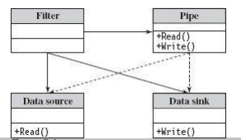
Data Flow Architectures
There are two types of filters: active and passive.
• An active filter pulls in data and pushes out the transformed data (pull/push); it works with a passive pipe that provides read/write mechanisms for pulling and pushing.
• A passive filter lets connected pipes push data in and pull data out. It works with active pipes that pull data out from a filter and push data into the next filter.

Slide 15
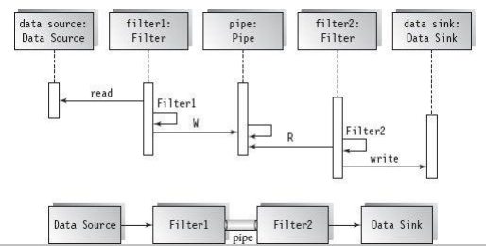
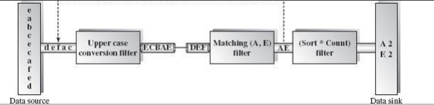
Data Flow Architectures
An Example of Pipe and Filter Architecture

Slide 16
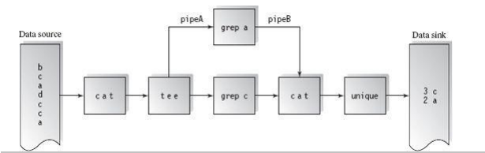
Data Flow Architectures
Pipe and Filter in Unix
Who | wc –l

Slide 17
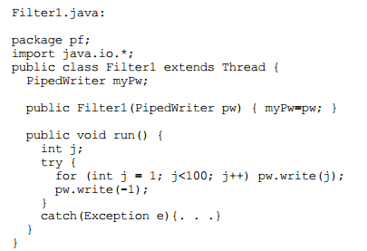
Data Flow Architectures
Pipe and Filter in Java
The Java API provides the PipedWriter and PipedReader classes in the java.io package

Slide 18
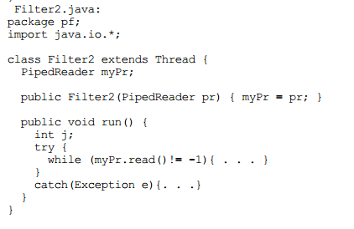
Data Flow Architectures

Slide 19
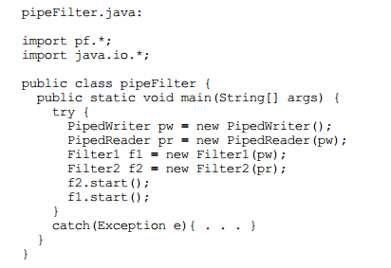
Data Flow Architectures

Slide 20
Data Flow Architectures
Benefits:
• Concurrency: It provides high overall throughput for excessive data processing
• Reusability: Encapsulation of filters makes it easy to plug and play, and to substitute
• Modifiability: It features low coupling between filters, less impact from adding new filters, and modifying the implementation of any existing filters as long as the I/O interfaces are unchanged
• Simplicity: It offers clear division between any two filters connected by a pipe
• Flexibility: It supports both sequential and parallel execution

Slide 21
Data Flow Architectures
Limitations:
• It is not suitable for dynamic interactions
• A low common denominator is required for data transmission in the ASCII formats since filters may need to handle data streams in different formats, such as record type or XML type rather than character type
• Overhead of data transformation among filters such as parsing is repeated in two consecutive filters
• It can be difficult to configure a pipe and filter system dynamically

Slide 22
Data Flow Architectures
Process Control Architecture
Process control software architecture is suitable for the embedded system software design where the system is manipulated by a process control variable data
Process control architecture decomposes the whole system into subsystems (modules) and connections between subsystems
A process control system must have the following process control data:
Controlled variable: a target controlled variable such as speed in a cruise control system or the temperature in an auto H/A system
Input variable: a measured input data such as the temperature of return air in a temperature control system

Slide 23
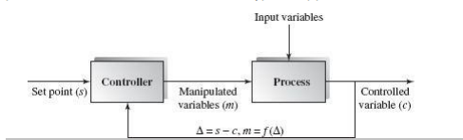
Data Flow Architectures
Manipulated variable: can be adjusted by the controller.

Slide 24
Data Flow Architectures
Applicable domains of process control architecture:
• Embedded software systems involving continuing actions
• Systems that need to maintain an output data at a stable level
• The system can have a set point—the goal the system will reach at its operational level.
Benefits of close-loop feedback process control architecture over open forward architecture:
• It offers a better solution to the control system where no precise formula can be used to decide the manipulated variable
• The software can be completely embedded in the devices

Slide 25
Summary
The data flow software architecture style views the entire software system as a series of transformations on successive sets of data
Pipe and filter architecture is another type of data flow architecture where the flow is driven by data
Process control software architecture is suitable for the embedded system software design

